Slide 1
DATA MINING PROJECT
GROUP 3:
DISHA NEVE
GAURI NAIK
TANUJ SAWANT

Slide 2
PREDICTIVE ANALYTICS FOR UNIVERSITY SELECTION

Slide 3
AGENDA
Introduction
Objective
Data
Source
Cleaning
Data Visualization and Insights
Modeling
Building Models
Individual Performance
Comparative Analytics
Sentiment Analysis Visualization
Comparative Analysis USF vs UTD
Insights
Business Application
Conclusion

Slide 4
INTRODUCTION
University selection is a crucial task for every student.
A candidate with a good profile is an asset for any university.
Universities constantly seek for potential candidates who would be an enrichment to the current pool of students.
Universities have a distinguishing traits which assist students to be admitted to that university.

Slide 5
OBJECTIVE
To develop a predictive model for USF’s ISDS department to determine the students profile who gets admitted to BAIS course and accept the admit .
To explore the parameters which influence candidates decision to choose other universities over USF.
Comparative analytics for USF.

Slide 6
DATA : SOURCE
Web scrapping
https://yocket.in/profiles
The data was web scrapped from Yocket website using python to fetch students profiles.
New Data Generation(Survey)
https://www.surveymonkey.com/r/SWJ5XHQ
New data was generated by creating a survey which was taken by BAIS Fall 2017 students.

Slide 7
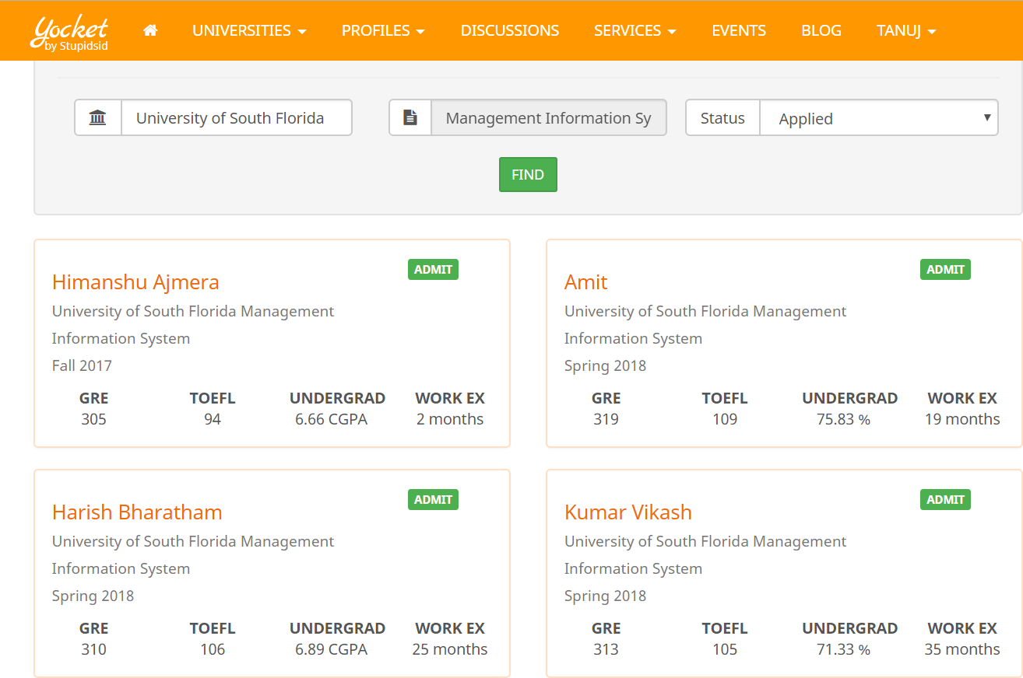
RAW DATA

Slide 8
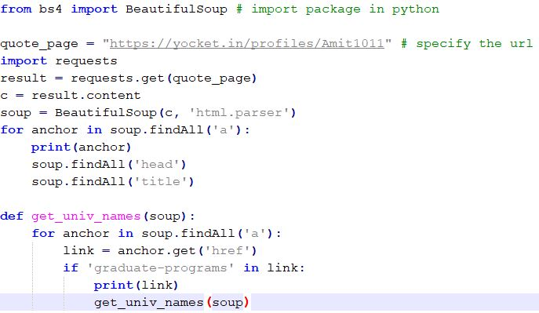
PYTHON SCRIPT – WEB SCRAPPING

Slide 9
CLEANING DATA
Rows containing junk and garbage values were imputed.
Redundant columns such as “Undergrad college”, “Pass out year” were eliminated to make it lightweight.
Missing values were filled by calculating mean.
Rows containing IELTS score were normalized as per TOEFL standards.
Percentage and GPA were converted on a scale of 10.
Categorical names of universities were converted to binary values(0-Non USF; 1-USF).

Slide 10
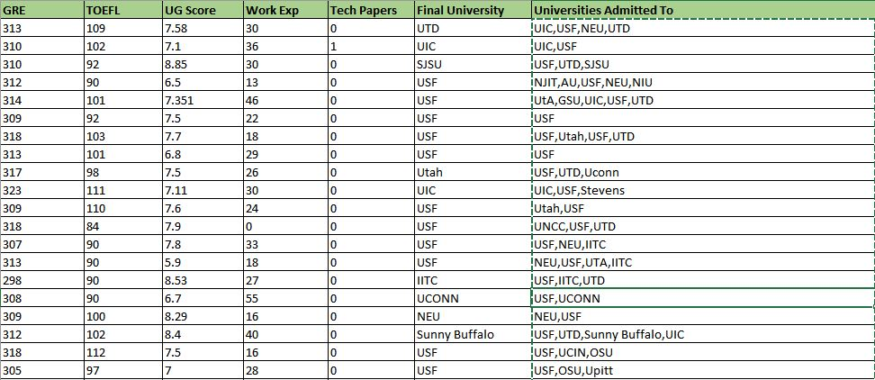
CLEANED DATASET

Slide 11
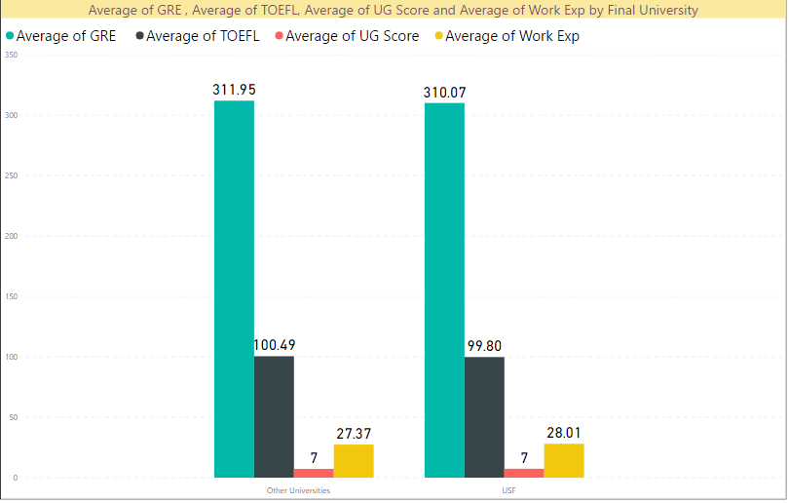
DESCRIPTIVE ANALYTICS

Slide 12
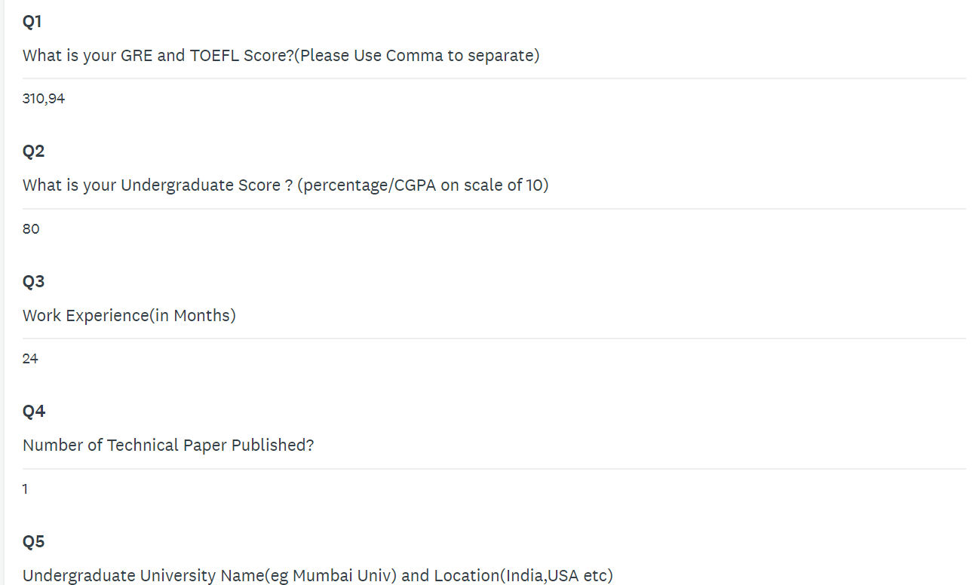
SURVEY DATA

Slide 13
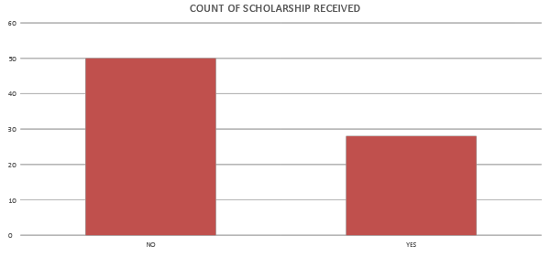
DATA VISUALIZATION

Slide 14
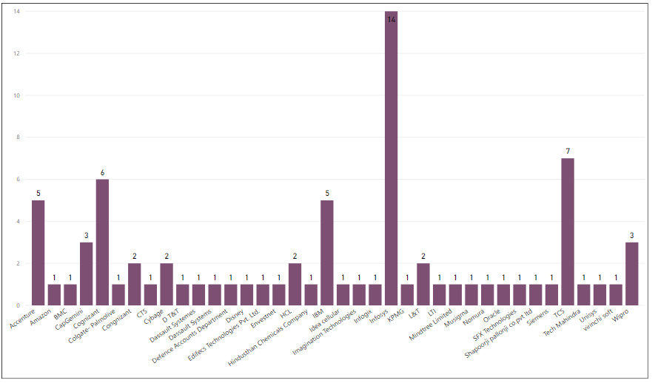
STUDENT COUNT BASED ON ORGANIZATIONS

Slide 15
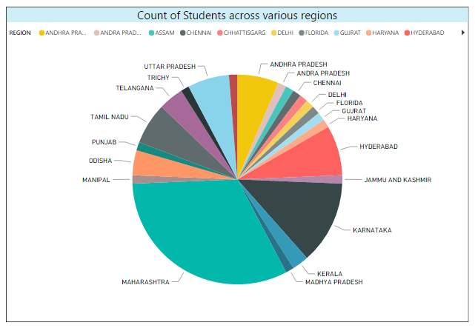
REGION WISE COUNT OF STUDENTS

Slide 16
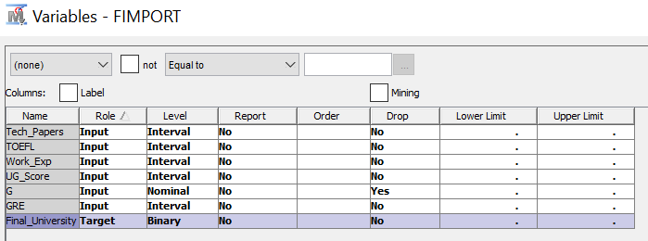
MODELING : VARIABLE PARAMETERS

Slide 17
BUILDING MODELS
We have implemented 9 predictive models on our cleaned data.
The reason behind implementing variety of models is to perform comparative analysis of all models on the same dataset.
The accuracies, misclassification rates and confusion matrix are indicators of model performance.
ROC Curve and Cumulative % Captured response charts are used for comparative analysis.

Slide 18
MODELS
Regression
Decision Tree
Support Vector
Gradient Boosting
DMINE Regression
Neural Network
Naïves Bayes Classifier
Memory Based Reasoning
Generalized Linear Model(GLM)

Slide 19
COMBINATION OF MODELS
HP Forest
Ensemble

Slide 20
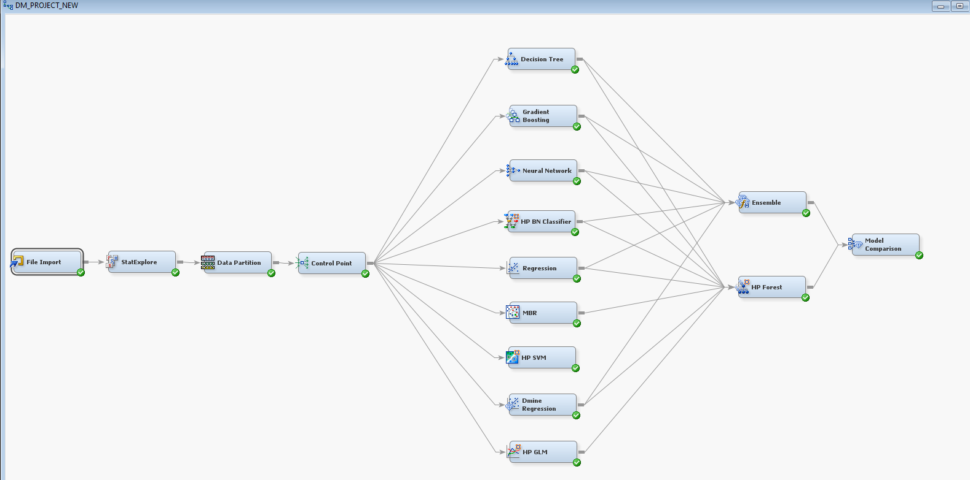
FINAL MODEL

Slide 21
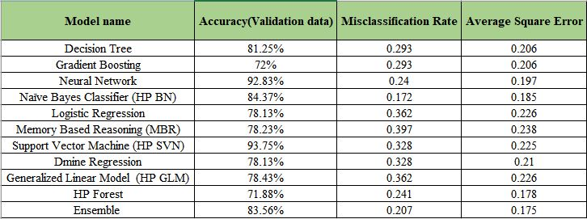
RESULT
The ROC Curve and Cumulative percentage plots have been plotted here.
The Accuracy , Misclassification rate and Average Square Error of the models is calculated as follows:

Slide 22
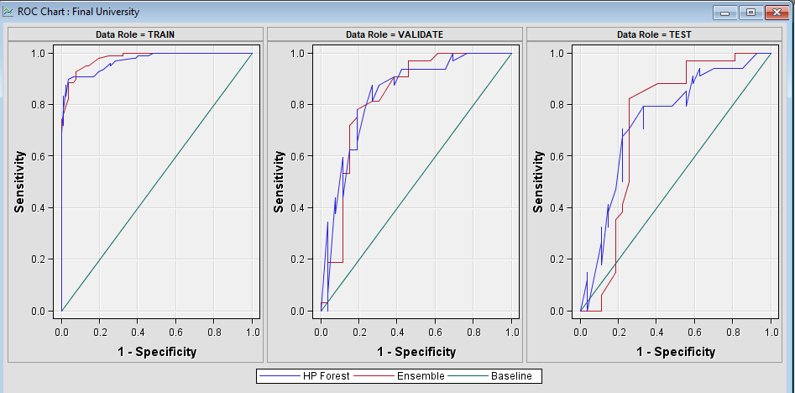
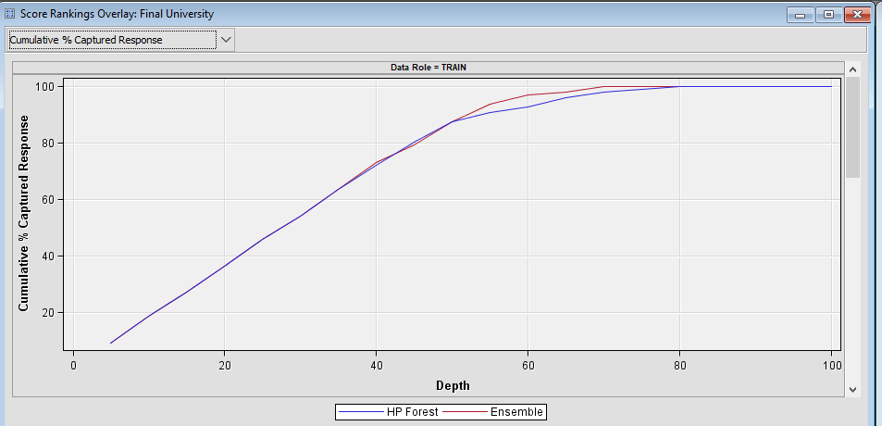
COMPARITIVE ANALYTICS
ROC Curve Chart
CUMULATIVE % CAPTURED RESPONSE

Slide 23
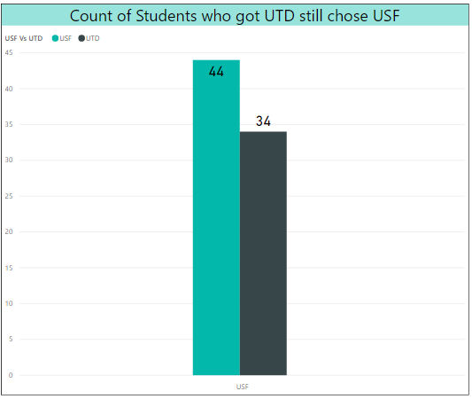
COMPARATIVE ANALYTICS – USF VS UTD

Slide 24
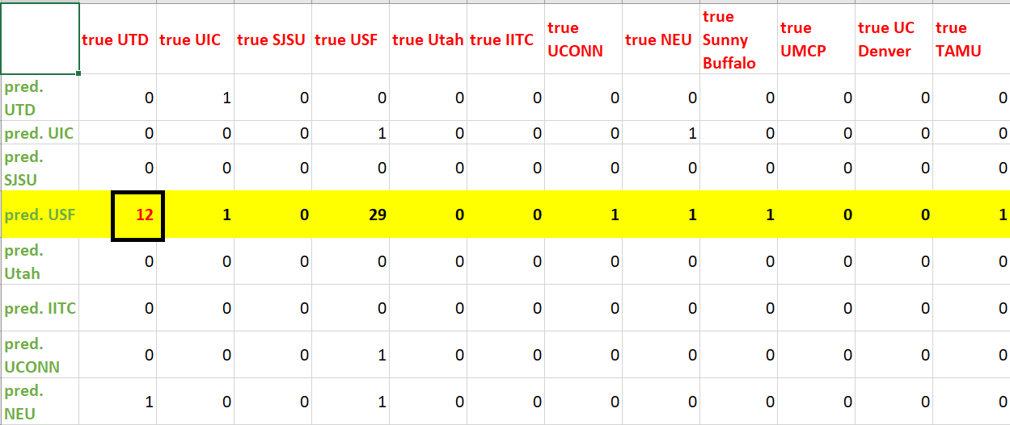
CONFUSION MATRIX FOR USF VS UTD

Slide 25
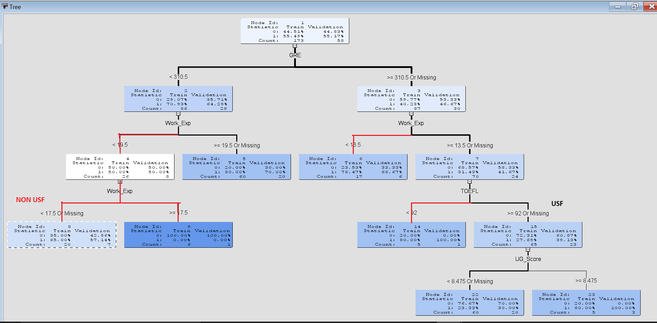
DECISION TREE : USF VS NON USF

Slide 26
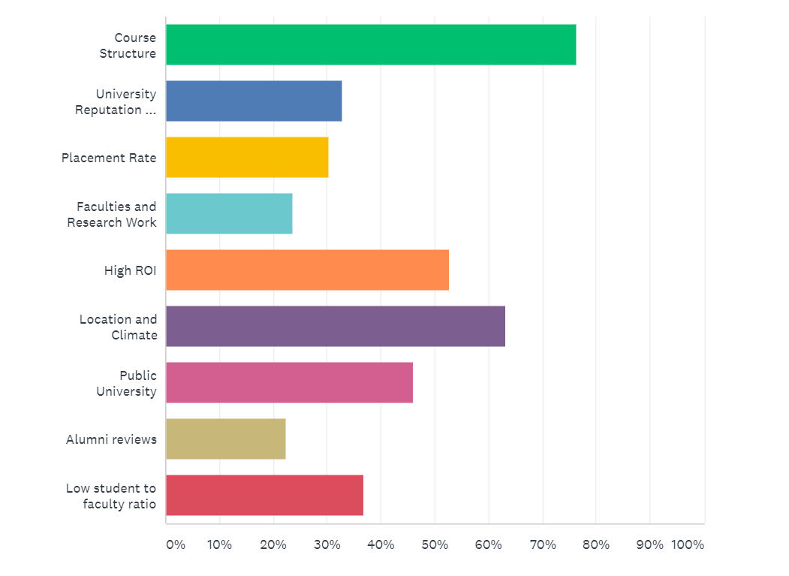
INFLUENTIAL SENTIMENTS FOR FINALIZING USF

Slide 27
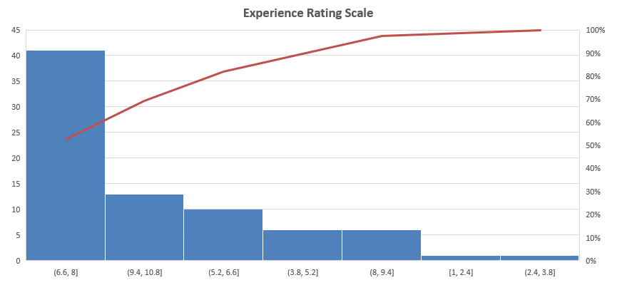
EXPERIENCE RATING OF STUDENTS

Slide 28
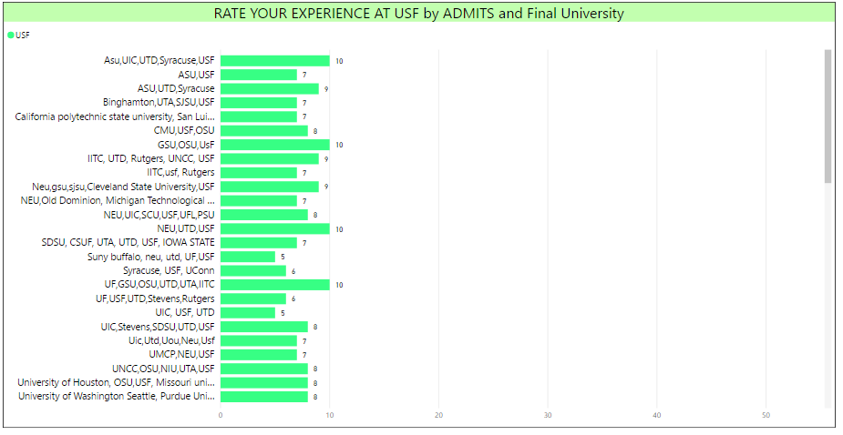
RATINGS FOR USF VS OTHER UNIVERSITIES

Slide 29
INSIGHTS
The model is getting confused between USF and UTD since the scrapped data was for USF and out of them many students got admitted to UTD as well.
The reason for this was data skewness. We observed that the parameters based on which the model predicts USF are quite similar to UTD.
From the dimension reduction technique PCA, we determined the correlation between the attributes.
Chi-Square plot gave us the set of most significant variables.
Candidates having scholarships from different universities also chose USF over them.
It was observed that most students with final university as USF have average work experience of about 24 months.

Slide 30
BUSINESS APPLICATIONS
Predict if students choose USF over other universities.
Sentiment analytics to find factors for choosing USF.
Leveraging those factors and using it for marketing and to reach out to more students.
Comparative analytics for UTD and USF. Giving them an edge over their competitors.

Slide 31
CONCLUSION
With the help of Yocket and survey data, we have successfully performed predictive analysis for USF to determine the incoming potential candidates.
We have determined the parameters for candidates selecting other universities(UTD).
This model will help to target student segment which will accept USF as their final university.

Slide 32
Thank you!

